Slide 1
IST 263
Links, Images and Video

Slide 2
AGENDA
Review VS Code & GitHub Process
Copyright and Intellectual Property
Paths
HTML Attributes and Links
Images
Embedding Content

Slide 3
Copyright and Intellectual Property

Slide 4

What do you know about copyright?
Class Survey

Slide 5
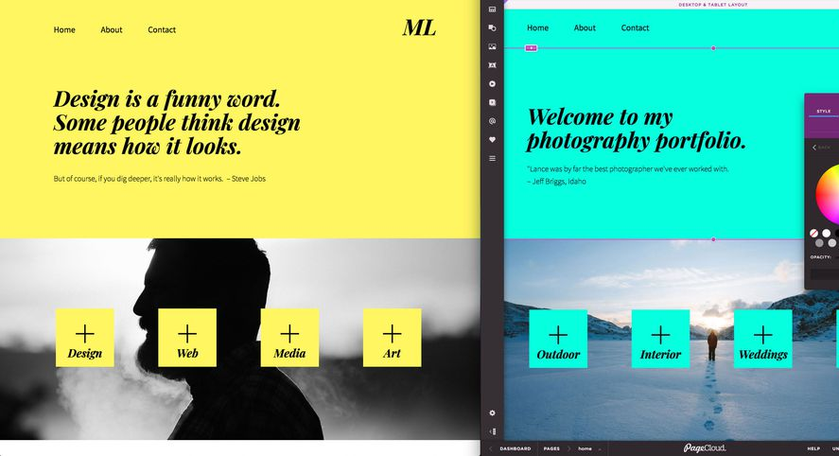
Copyright and Intellectual Property Scenarios
Your client looked at a competitor's website and would like to copy their layout. Basically, put their images and text in the same arrangement as on the competitor's website. Is this legal? Is it ethical?

Slide 6

Copyright and Intellectual Property Scenarios
Your salon client provide images of people cutting hair and doing manicures, but they don’t look like photos that were taken in the business. In a conversation with them you find out they are cropped versions of images for a Google images search. Is it legal? Is it ethical?

Slide 7

Copyright and Intellectual Property Scenarios
You’ve bought stock photography for a website you are creating for a medical company. The website advertised their new incontinence drug. Is it legal to use the stock photography for this? Is it ethical?

Slide 8

Copyright and Intellectual Property Scenarios
You do a photoshoot with a model who later decides she doesn’t want her photo associated with the OBGYN doctor’s website.

Slide 9
Copyright and Intellectual Property
Activity
Blackboard -> Content -> Unit 03 -> unit_03-intellectual_property_activity.docx

Slide 10
Copyright and Intellectual Property
Do I need to file a claim with the government to get copyright protection?
What is fair use?
If I create a thumbnail of an image and then link to the original, is this okay?
What happens to your copyright when you post an image of original art on a social media website?
When you buy a stock image can you do anything you want with it?
Websites like Smitten Kitchen have made money publishing other folks recipes. What are the legal issues around this? Is it ethical?
What do you think is ethical when it comes to using other people’s creations?

Slide 11
HTML Attributes and Links

Slide 12
HTML Attributes
All HTML elements can have attributes
Attributes provide additional information about elements
Attributes are always specified in the start tag
Attributes usually come in name/value pairs like: name="value"

Slide 13
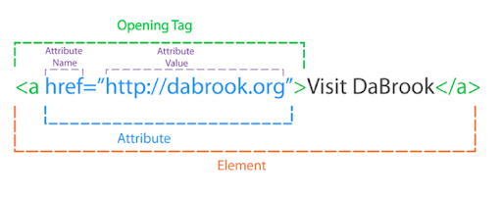
HTML Attributes and Links

Slide 14
Link Paths
What | Note | Example
External Link | Full url including http | <a href="http://www.google.com">Google</a>
Relative Link | Refer to page based on the current page's relative location | <a href="about.htm">Page in Same Folder</a>
Note: Paths to files and paths to images work the same way.

Slide 15
More on Relative Link Paths
What | Example
Within Directory | <a href="about.htm">About Us</a>
In Directory Above | <a href="../about.htm">About Us</a>
In Two Directories Above | <a href="../../about.htm"> About Us</a>
In Directory Below | <a href="about/about.htm">About Us</a>
In two directories Down | <a href="about/about/about.htm">About Us</a>

Slide 16
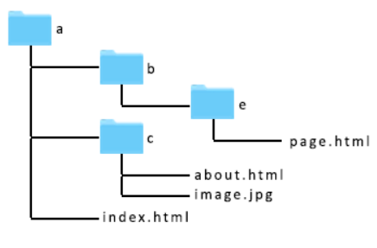
Path Rules
Determine the folder your file resides in.
Traveling only along the lines figure out the path you want to travel to get to the folder that contains the file you want to link to.
Every time you go up to a parent folder you add a ../
Every time you go down to a sub folder you add a /folder_name where folder_name is the actual name of your folder
Once you have arrived at the correct folder, add a /file_name to the end of your path where file_name is the actual name of your file.

Slide 17
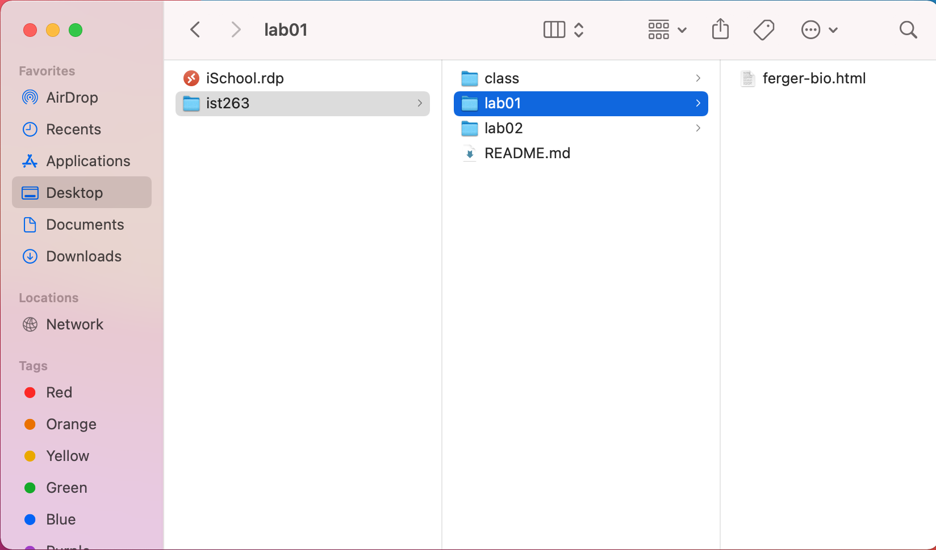
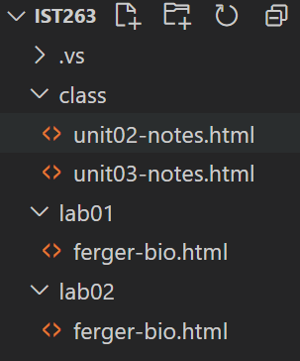
My IST263 Git Folder

Slide 18
Path from unit02-notes.html to ferger-bio.html in the lab01 folder

Slide 19
Bookmark Links
Want to link to content lower down your page. Use a bookmark link.
Bookmark links are two parts.
Link to content lower on the page (higher) using # sign.
Tag with id attribute.
<h1 id=“return”>Page Heading</h1>
<a href=“#return”></a>

Slide 20
Images

Slide 21
Images
Web image formats: PNG, JPEG, or GIF
Element – img is a void element
src attribute specifies image location
alt attribute describes image as text
<img src="images/photo.jpg" alt="my photo">

Slide 22
Embedding

Slide 23
Embedding with the <iframe> Tag
An inline frame is used to embed another document within the current HTML document
Title attribute describes the content of the iframe and should always be used
<iframe src="https://www.w3schools.com" title="W3Schools Free Online Web Tutorials"></iframe>

Slide 24
Embedding YouTube Videos
Find your video. I'll use this: https://youtu.be/eesqK59rhGA.
Click "Share" and choose "Embed"
Some HTML code will pop up. Copy it and paste it into your web page between the <body> tags. <iframe width="560" height="315" src="https://www.youtube.com/embed/eesqK59rhGA" frameborder="0" allow="accelerometer; autoplay; encrypted-media; gyroscope; picture-in-picture" allowfullscreen></iframe>

Slide 25
Embedding Podcasts (Using Spotify)
Use the Spotify desktop app
Click on the “…” next to the “Follow” (or on the individual episodes)
Click “copy embed code”
Paste the code into your website <iframe src="https://open.spotify.com/embed-podcast/episode/1OApzhja1uh479AuPcZ1KY" width="100%" height="232" frameborder="0" allowtransparency="true" allow="encrypted-media"></iframe>

